Slide 1
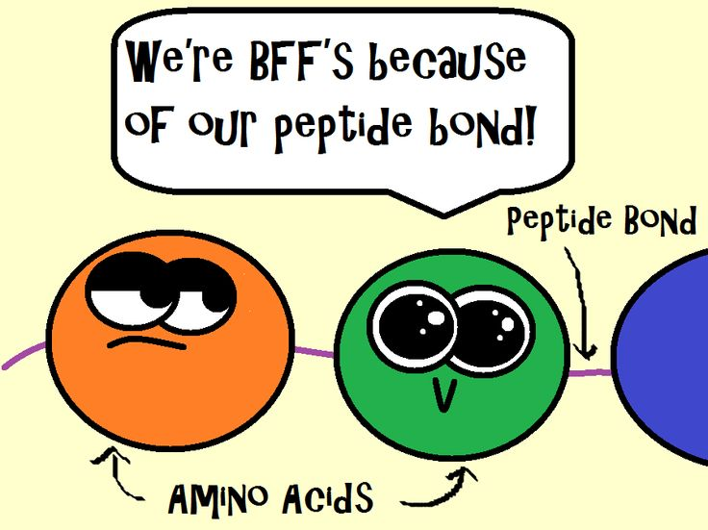
BB2950 Day 6: Thursday 11-2-17
Learning objectives:
Diagram the primary structure of proteins, indicating the alpha carbon, side chains, type of bond that connects the amino acids, and the N and C termini.
Explain the significance of amino acid side chains and describe the types of interactions they have with other molecules.
https://leapsmoothies.com/blog/makes-complete-protein-anyway-eat/

Slide 2
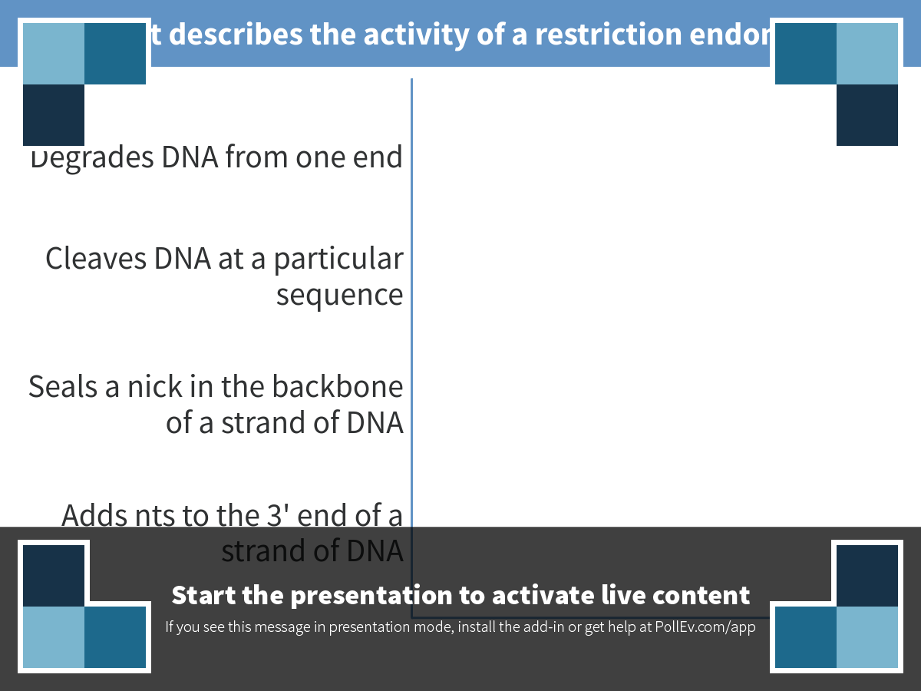
Notes:
What best describes the activity of a restriction endonuclease?
https://www.polleverywhere.com/multiple_choice_polls/H0xg5CEmQTsIPgx

Slide 3
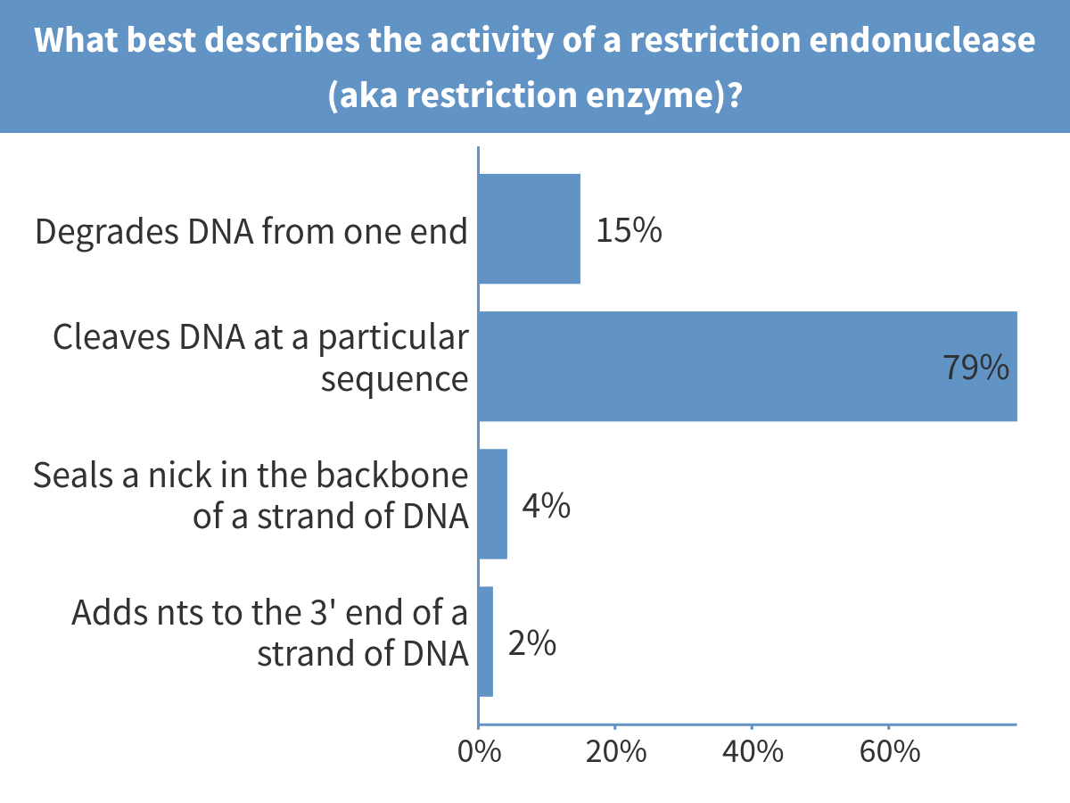
Notes:
What best describes the activity of a restriction endonuclease (aka restriction enzyme)?

Slide 4
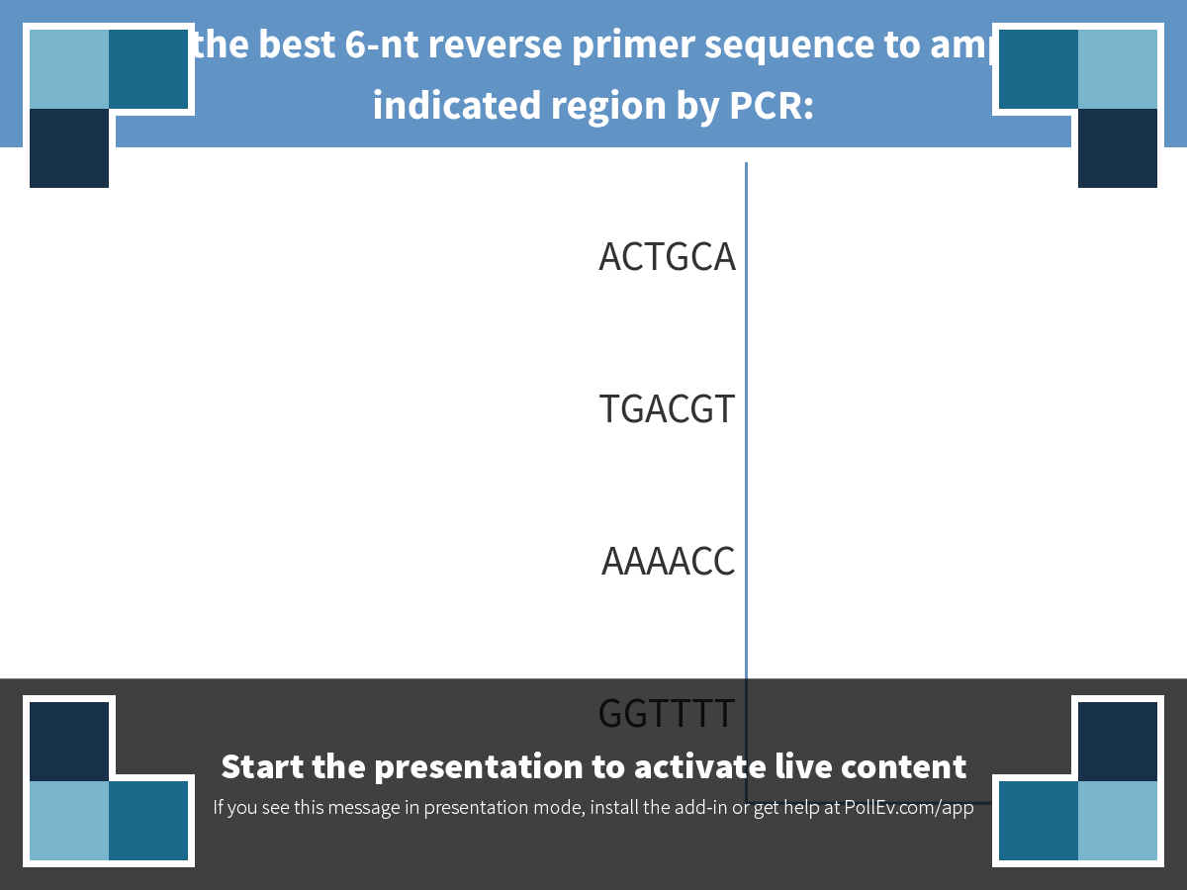
Notes:
What is the best 6-nt reverse primer sequence to amplify the indicated region by PCR:
https://www.polleverywhere.com/multiple_choice_polls/xg46Z1iDgS7Drpm

Slide 5
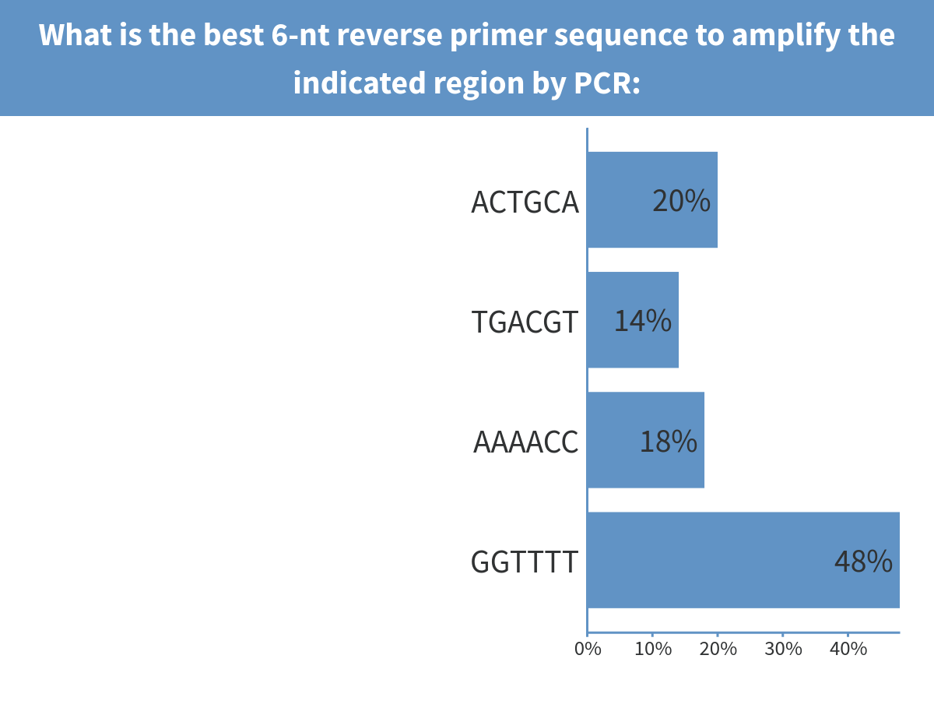
Notes:
What is the best 6-nt reverse primer sequence to amplify the indicated region by PCR:

Slide 6
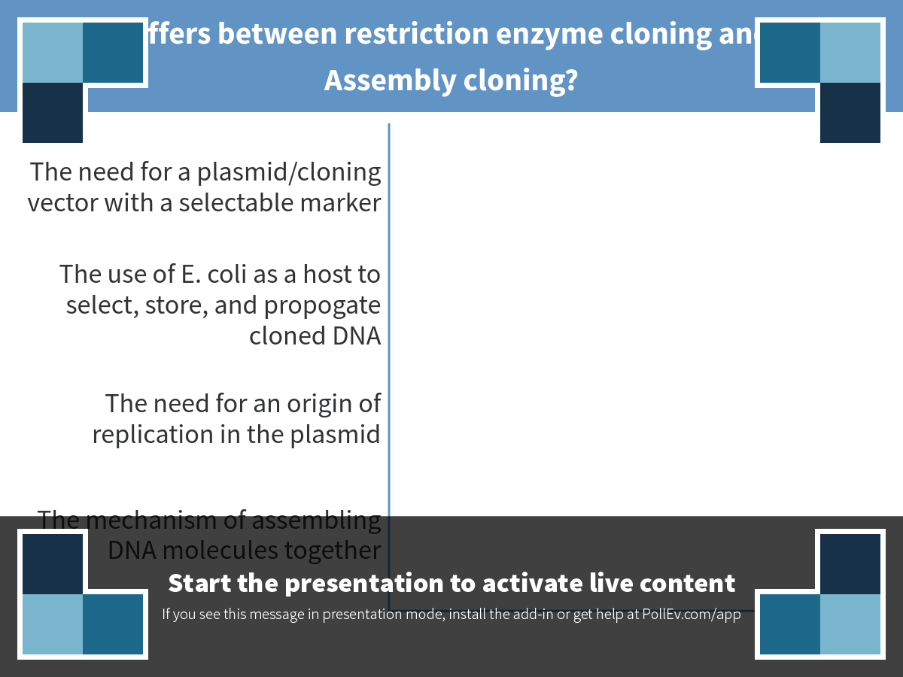
Notes:
Which differs between restriction enzyme cloning and Gibson Assembly cloning?
https://www.polleverywhere.com/multiple_choice_polls/o8cgnxbJgidgjzb

Slide 7
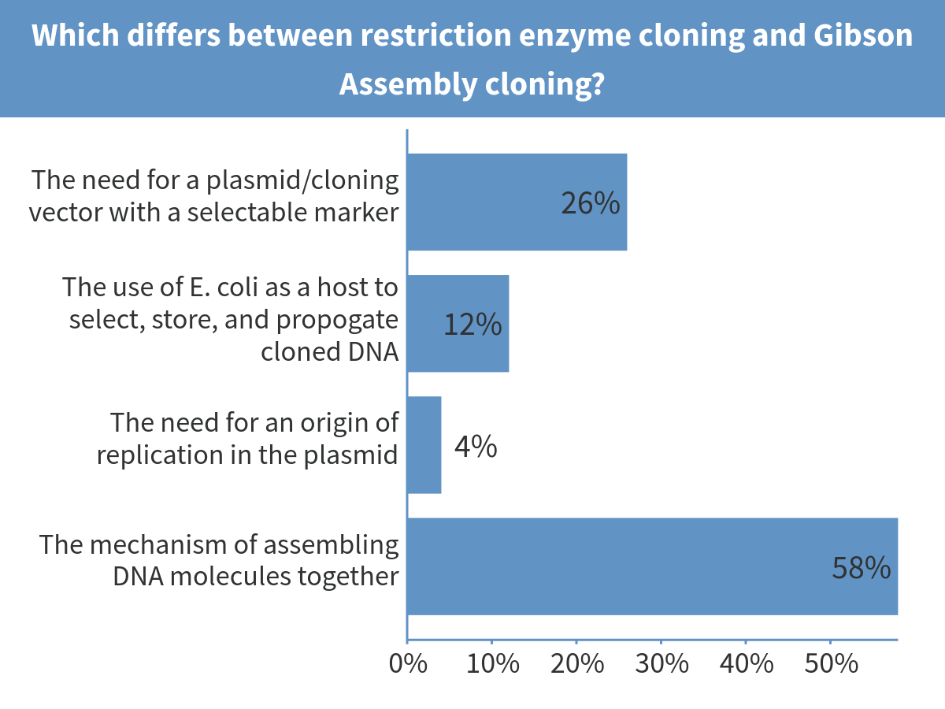
Notes:
Which differs between restriction enzyme cloning and Gibson Assembly cloning?

Slide 8
What sequences should I add to each primer to flank my pink gene with sequences for Gibson Assembly into the plasmid? To which ends of the primers do I add them?

Slide 10
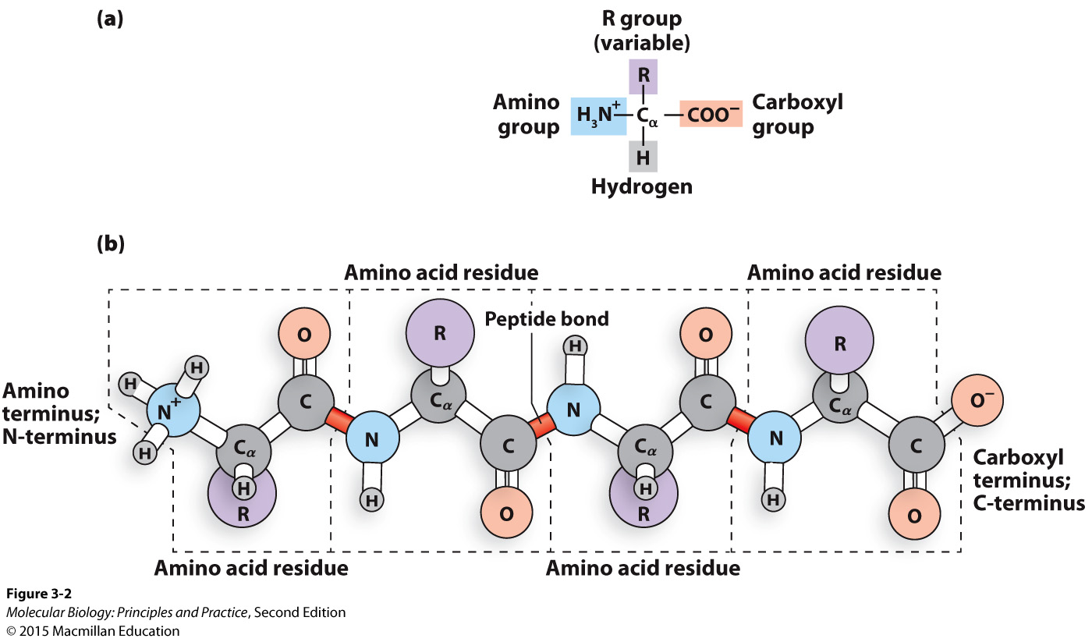
Proteins/peptides/polypeptides are chains of amino acids
Notes:
Draw chemical structure on board
Primary structure = sequence of amino acids
Highlight: N and C termini, residues, side chains, peptide bonds.
Sequence is written N term to C term

Slide 11
The chemical structure of a peptide backbone
Notes:
Draw chemical structure on board
Primary structure = sequence of amino acids
Highlight: N and C termini, residues, side chains, peptide bonds.
Sequence is written N term to C term

Slide 12
Broad categories of side chains

Slide 13
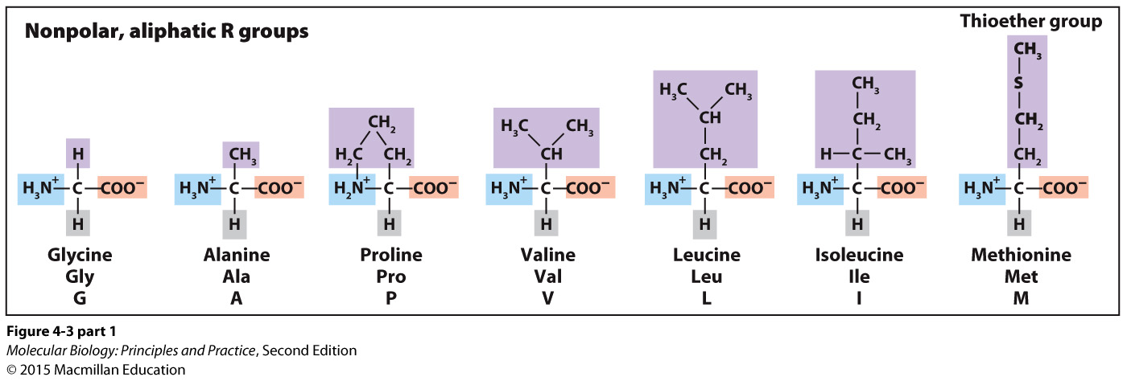
What kinds of interactions will nonpolar side chains have?

Slide 14
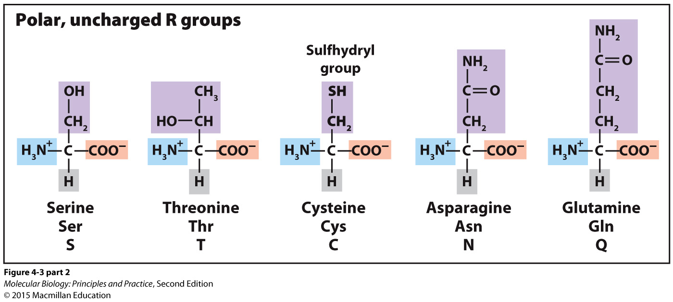
What kinds of interactions will polar, uncharged side chains have?

Slide 15
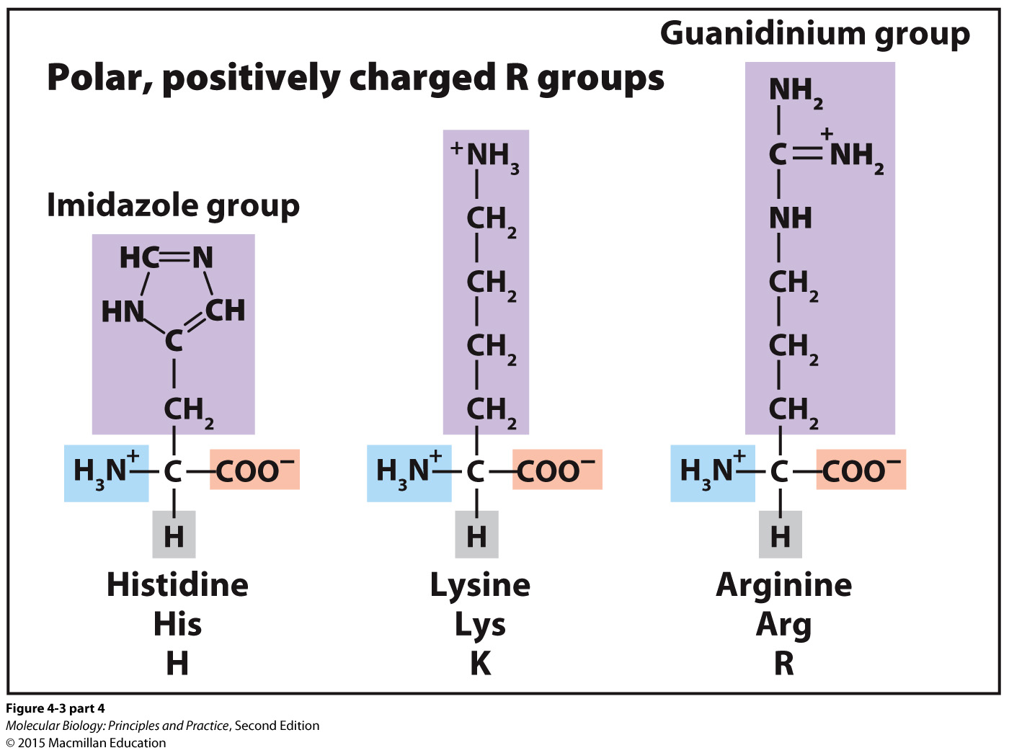
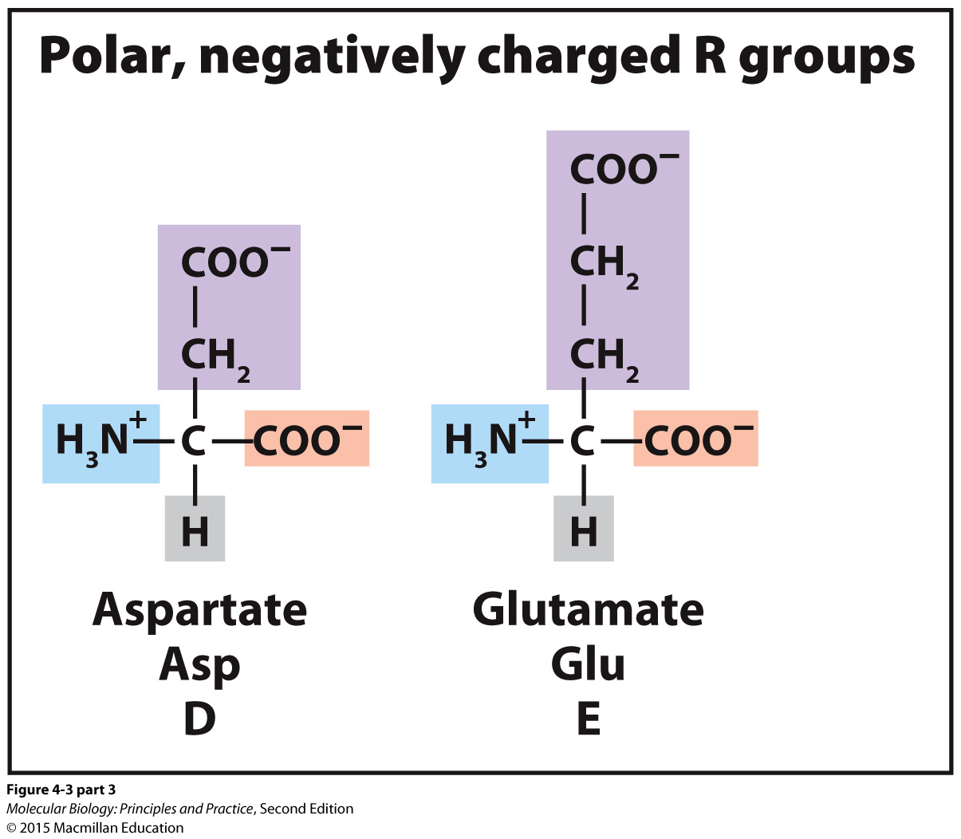
What kinds of interactions will polar, charged side chains have?

Slide 16
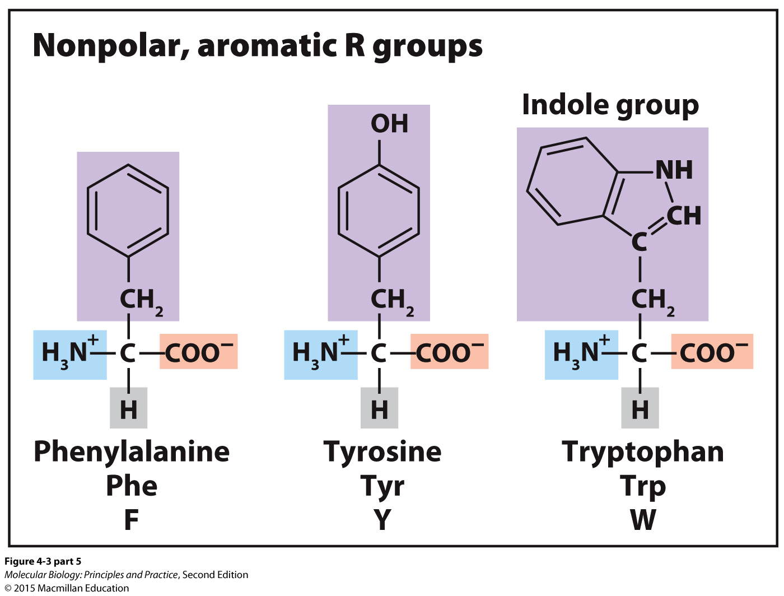
What kinds of interactions will aromatic side chains have?

